Slide 1


A story about three people… and a startup company
Christopher Noble
Massachusetts Institute of Technology

Slide 2
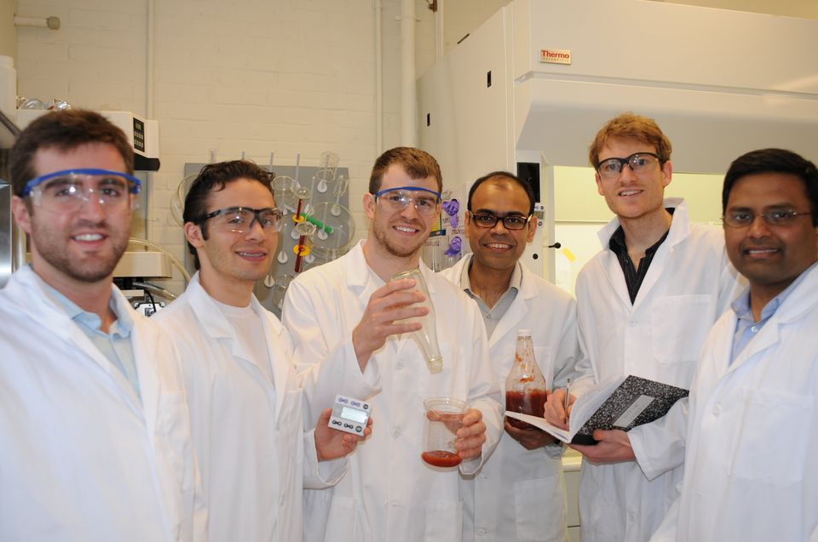
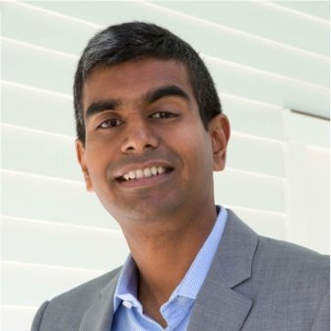
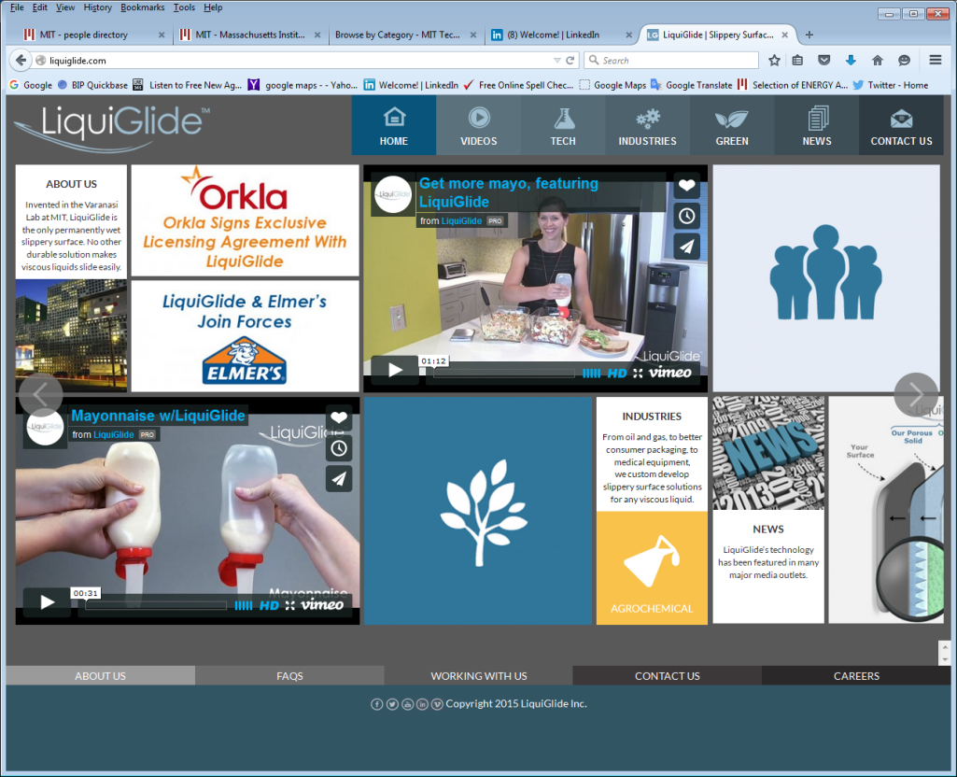
A story about three people…
David Smith, Ph.D. student
Prof. Kripa Varanasi
Colin Gounden, Angel Investor
… and a startup company

Slide 3
Chronology and the startup ecosystem
2004 2008 2009 Spring 2012 May 2012 May 2012 Summer 2012 Oct-Nov 2012 Early 2013 June 2014 | Kripa Varanasi receives PhD from MIT. Kripa Varanasi joins MIT faculty after working for GE Global Research. Dave Smith starts his PhD: Funding from NSF, DOD. iTeams and Venture Mentoring Service. MIT $100K Entrepreneurial contest: “Audience choice” award ($2K). Ketchup bottle video goes viral on YouTube. “LiquiGlide” team take “Founder’s Skills Accelerator” program at MIT Entrepreneurship Center; meet Colin Gounden at final presentation. Top prize ($100K) in MassChallenge annual startup contest (1300 entrants). Colin Gounden and serial entrepreneur join the LiquiGlide “team”. First Institutional financing, negotiated by Colin Gounden.
Faculty with industrial experience
Typical founder: PhD student. Government funding of the research project.
iTeams: Business Plan class for engineering and management students working together.
Venture Mentoring Service: volunteer mentors for startup companies (& training for Angels and mentors)
Entrepreneurial competitions: training & visibility for all the contestants
Founder’s Skills Accelerator: Summer course for startup teams before the spinout from MIT

Slide 4
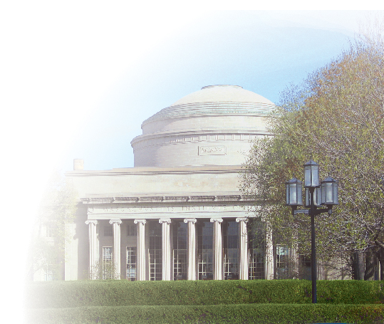
Thank You!
Christopher Noble Technology Licensing Officer Massachusetts Institute of Technology
crn@mit.edu
tlo.mit.edu

