Slide 1

TECHNOLOGY DEVELOPMENT
IN TURKEY
Threats and Opportunities
A. Mete Çakmakcı
4th Annual International Conference on
Managing Intellectual Property in Universities
Istanbul, October 30-31, 2014
© TTGV October 2014

Slide 2
CONVICTIONS/DISCLAIMERS
Good engineers (personal skills) do not necessarily imply good engineering (organizational strategy and processes)
R&D is a systemic documented act of team work, not some random heroic act. (There is no such thing as a top «R&Der»!) (inventors ≠ innovators ≠ R&D professionals)
R&D is not an exclusively privileged activity for technical professionals, or PhDs.
Turkey is a consistent laggard in every international benchmark (official and non-official explanations for that)
The data do not exist! (no explanations ?!)

Slide 3
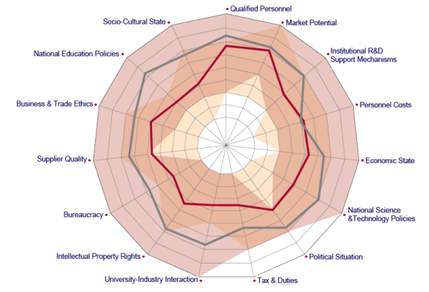
AN ATTRACTIVE ECOSYSTEM?
Significant chasm between our self image and outside image
Turkey
Others
Source : YASED

Slide 4
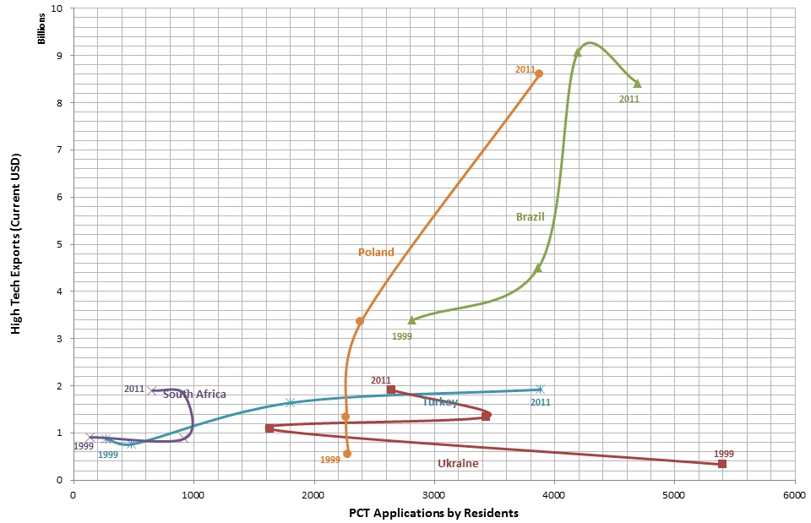
HIGH TECH EXPORT GROWTH
Source : Worldbank Data

Slide 5
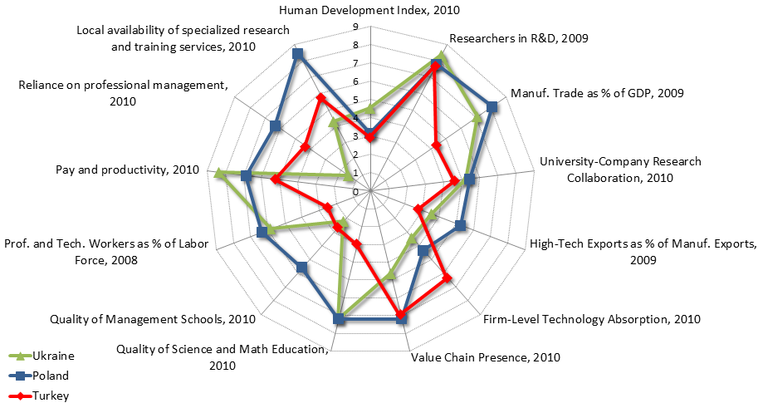
TRI-NATION BENCHMARK
Source : World Bank KAM

Slide 6
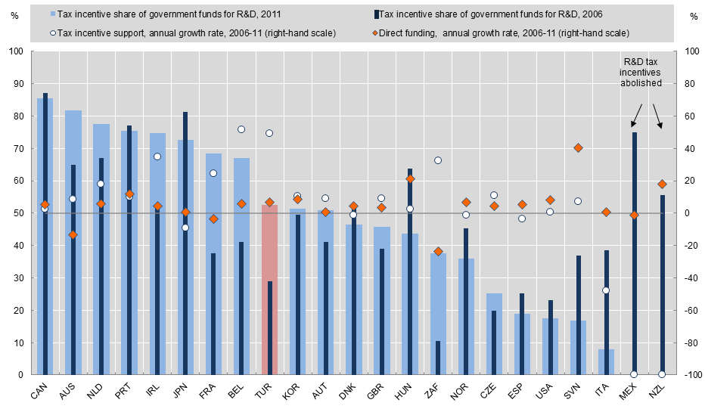
R&D INCENTIVES
Source : OECD STI 2013

Slide 7
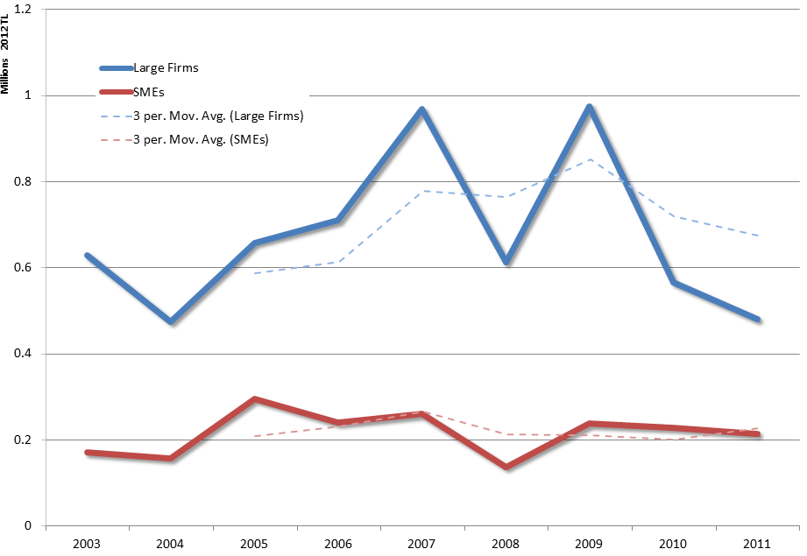
AIMING HIGHER?
Source : TÜBİTAK Data

Slide 8
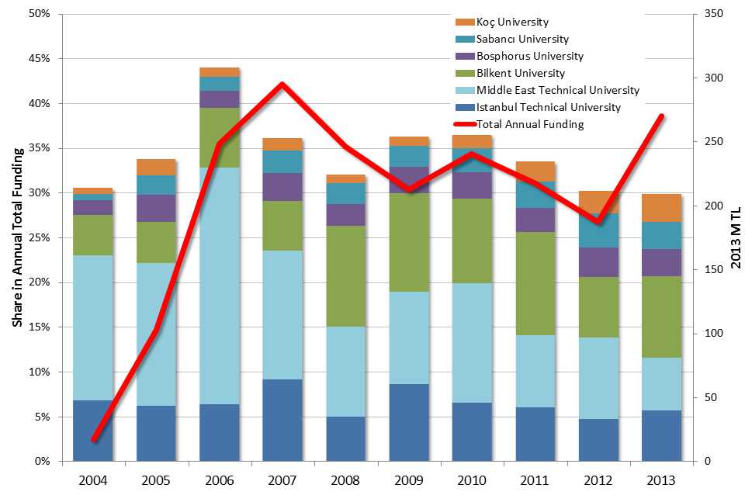
CRITICAL MASS?
Source : TÜBİTAK Data

Slide 9
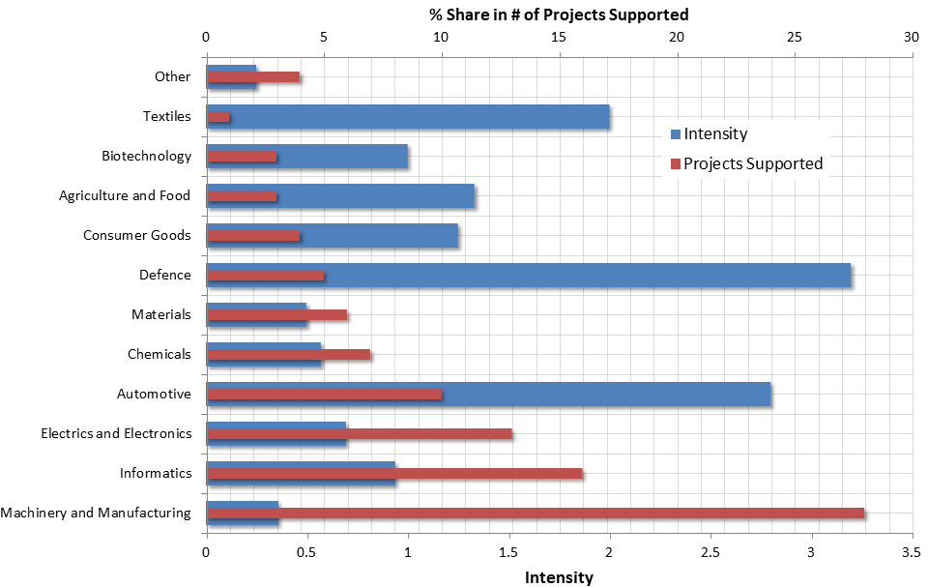
THEMATIC R&D INTENSITY
Source : TÜBİTAK Data

Slide 10
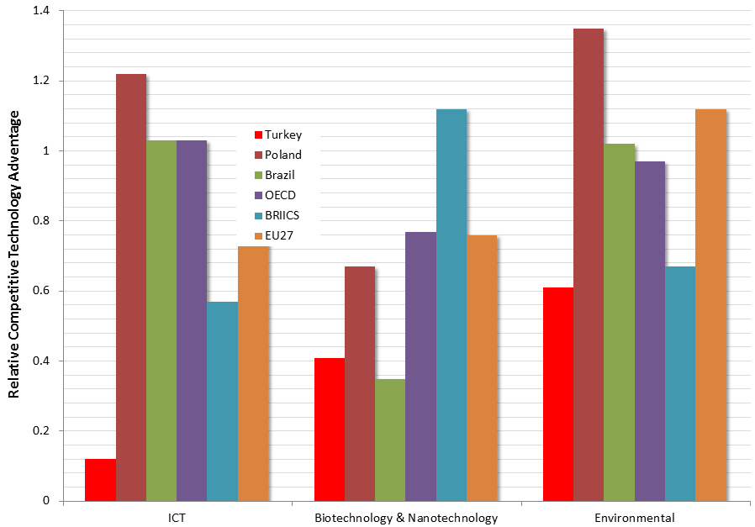
FUTURE TECHNOLOGIES
Source : OECD STI 2013

Slide 11
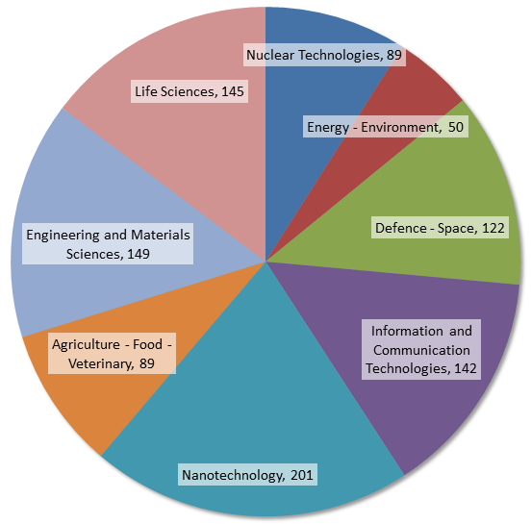
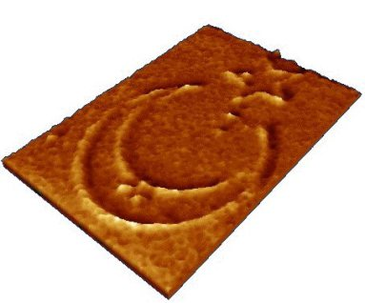
THEMATIC INVESTMENTS 2003 - 2010
Often times, research infrastructure investments are carried out indepent of regional or sectoral priorities.
World’s Smallest
Turkish Flag!
Source : Ministry of Development

Slide 12
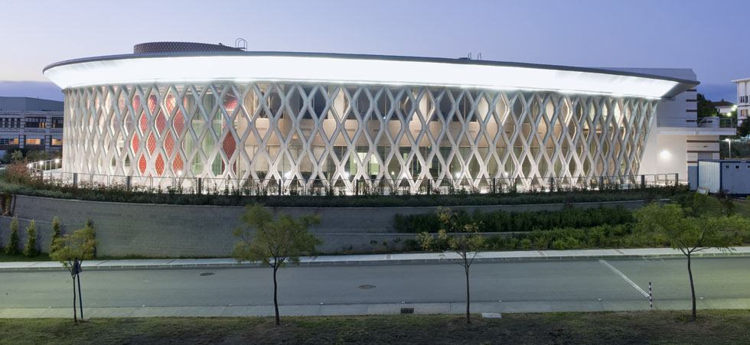


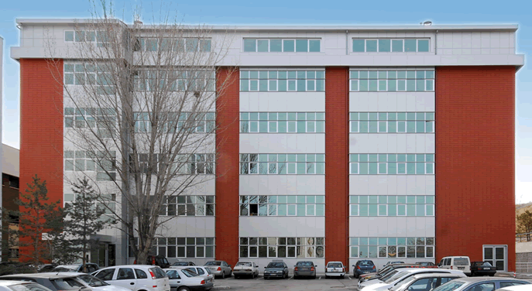
A TALE OF TWO CENTERS
Professional Management
Research for technology
Strong vision for industry collaboration
Private Universities
Academic Management
Research for science
Weak vision/bad communications
Solid vision and strong professional leadership is key for success!

Slide 13
KNOWLEDGE STREAMS
Basic and Applied Research
National Knowledge Stream
Policy
Gravity
Upstream
Precompetitive
Collboration
Industrial
Research
Research Centers
Midstream
Feedback
Stream
Product/Service
Development
Private R&D Centers
Downstream
Innovation «Delta»
Technoparks
Market

Slide 14
SOURCING IDEAS FOR RESEARCH
UPSTREAM
Discover and Identify the Problem
Through a Creative Process
(What if...)
Strong
Intellectual
Capital/TRADITION
MIDSTREAM
Work on A Well Defined Real Problem
(The Challenge)
Facilitation
Market
Enablers
LINKAGES TO
PROBLEM SOURCE
Firms
The Innovation Frontier
In Our Business
DOWNSTREAM
DIFFICULT TO CREATE
NOVEL VALUE
Search and Select the Problem
Through Popularity Indexes
(Me too...)

Slide 15
INSTITUTIONAL SILOS
Technology Supplier
SME
Tax
Deduction
Build New
Technology
Capacity
State
Private Company
R&D Center
Law # 5746
University
Adopt/Share Costs
Research Center
Contract Research
Different Government Silos

Slide 16
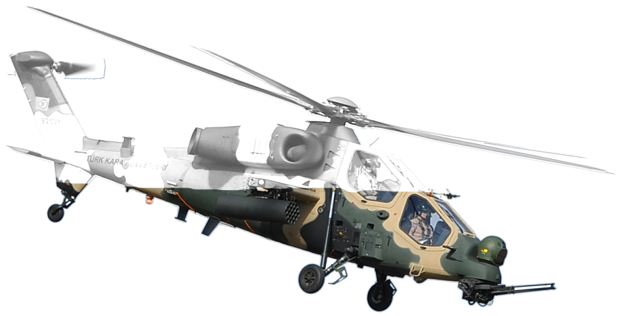
DEFENSE IMPACT?
State’s only public technology industrialization policy exists for the defense industries
Spillovers to other sectors
have been limited.
World class technology
development/management
capabilities and skills.

Slide 17
OPPORTUNITIES
Many elements of a functional system is already in place, making them work together is a learning process.
There are many best/good practices available, visibility of the outcomes will speed up the learning process.
Many companies are already deploying sophisticated organizational/ecosystem innovations.
Turkey is rich in innovation opportunities, many of which are relevant in most other places.
Turkey has a strong services sector, competitive internationally, a strong multiplier for market access.

Slide 18
WHO IS TTGV?
A public-private partnership with the mission to support the private sector’s technology development and innovation based competitiveness,
One of four «Foundation Established by Law» operating in the Republic of Turkey,
An independent and transparent organization subject to private law,
A trail blazer in the innovation ecosystem.

Slide 19
HOW TTGV WORKS?
Value Management
Contract
Market Hurdles
Contract
Sponsor
Sponsor
Financial Model
Activity
Model
Activity
Financial Model
Beneficiary
Intermediary Models
(Funds, Programs)
Service Models
(Consultancy, Projects)
(Loans, Grants, Equity etc.)
Innovation
Management
Pilot Application
and Model Validation

Slide 20


www.ttgv.org.tr
TTGV is a
member

